Slide 1

Unit 1

Slide 2

“A product is something made in the factory; a brand is something the customer buys. A product can be copied or imitated by a competitor; a brand is unique. A product can be outdated; a successful brand is timeless.”
– Stephen King (WPP Group, London)

Slide 3
What is a Brand?
“A name, term, design, symbol, or any other feature that identifies one seller’s good or service as distinct from those of other sellers. The legal term for brand is trademark. A brand may identify one item, a family of items, or all items of that seller. If used for the firm as a whole, the preferred term is trade name.”
- American Marketing Association

Slide 4

What is Brand Management?
Brand management helps to manage the tangible and intangible characteristics of a brand. A competent Brand Management includes building brand identity, launching the brand, and maintaining the brand position in the market.
Brand management builds and maintains the corporate image of a business.

Slide 5

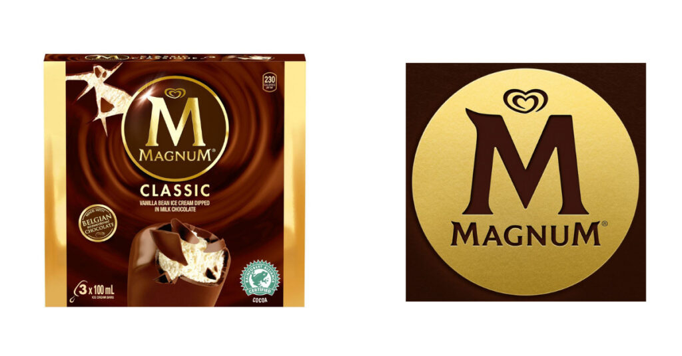
Brand Essence
Authenticity
Consistency
Durability
Experience
Uniqueness
Relevance
Single mindedness

Slide 6

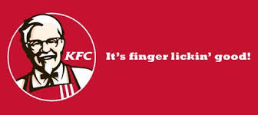
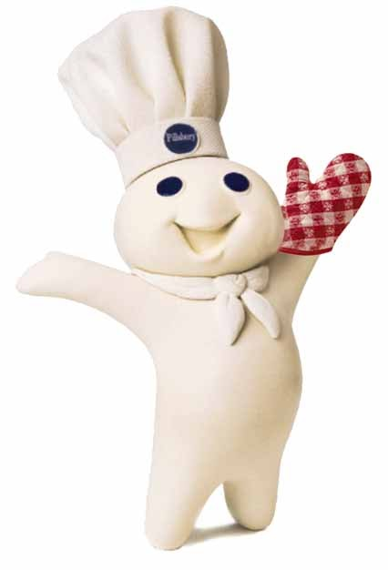
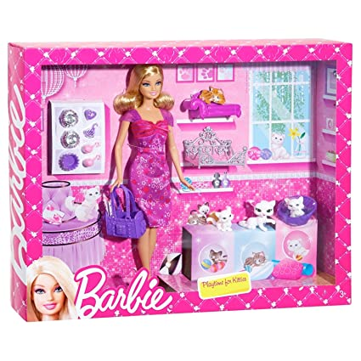
Brand Elements

Slide 7
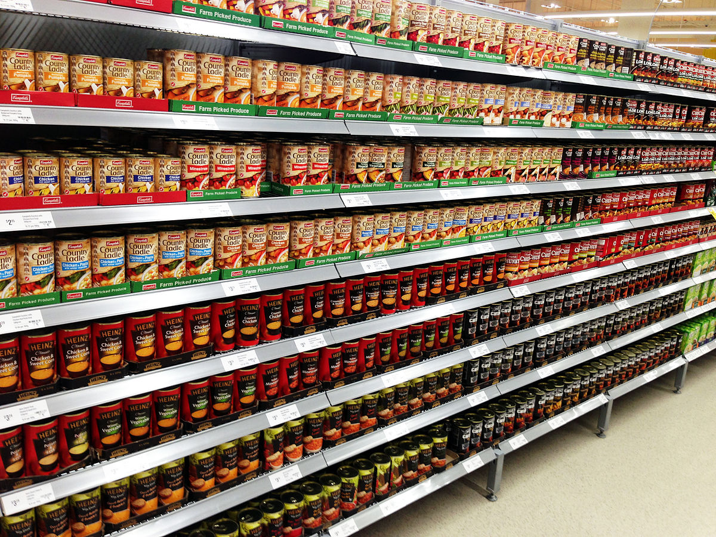
A Brand Comprises of
Tangible attributes
Intangible attributes
Product
Packaging
Labelling
Attributes
Functional benefits
Quality
Emotional benefits
Values
Culture
Image

Slide 8

Branding Challenges and Opportunities
Savvy Customers
Brand Proliferation
Increased Competition
Media Fragmentation
Increased Costs
Greater Accountability

Slide 9

Types of Brands
Product brands
Service brands
Business brands
Personal brands
Personality brands

Slide 10
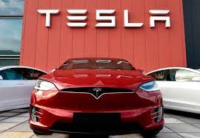



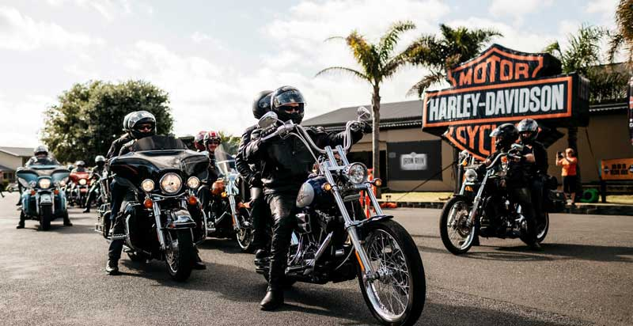

Slide 11

Strategic Brand Management
Strategic brand management involves the design and implementation of marketing programs and activities to build, measure, and message brand equity

Slide 12

Strategic Brand Management Process
Identifying and establishing brand positioning
Planning and Implementation of Brand Marketing Programs
Measuring and Interpreting Brand Performance
Growing and Sustaining Brand Equity

Slide 13
Identifying And Establishing Brand Positioning
Points of difference
Mental Map
Core Brand Associations
Brand Mantra

Slide 14
Planning and Implementation of Brand Marketing Programs
Choosing Brand Elements
Integrating the Brand into Marketing Activities and the Support Marketing Program
Leveraging Secondary Associations

Slide 15
Measuring and Interpreting Brand Performance
Brand Audit
Brand Value chain
Brand Equity Measurement System

Slide 16
Growing and Sustaining Brand Equity
Defining the brand strategy
Managing Brand Equity over time
Managing Brand Equity over Geographic boundaries, Market segments

Slide 17

BRAND & ITS OBJECTIVE
What problem does my brand solve?
Who is my ideal customer?
Who is my competition?
What does my brand make my customers feel?
Why do my customers trust me?
What is the story behind why my brand was created?
If my brand was a person, what would their personality be like?
What are my customers wanting/needing or struggling with?

Slide 18

Brand Concepts
Brand Name
Brand Attribute
Brand Positioning
Brand Identity
Brand Image
Brand Personality
Brand Awareness

Slide 19

Cont..,
Brand Loyalty
Brand Association
Brand Equity
Brand Extension
Co-Branding
Sonic Branding

Slide 20

What is Brand Architecture?
Brand architecture provides a hierarchy that depicts the roles and relationships within the products and services that make a company’s portfolio and makes sure that the external stakeholders understand the value of what the brands offer.

Slide 21
Types of Brand Architecture
The Branded House
The House of Brands
Endorsed Architecture
Hybrid Architecture

Slide 22
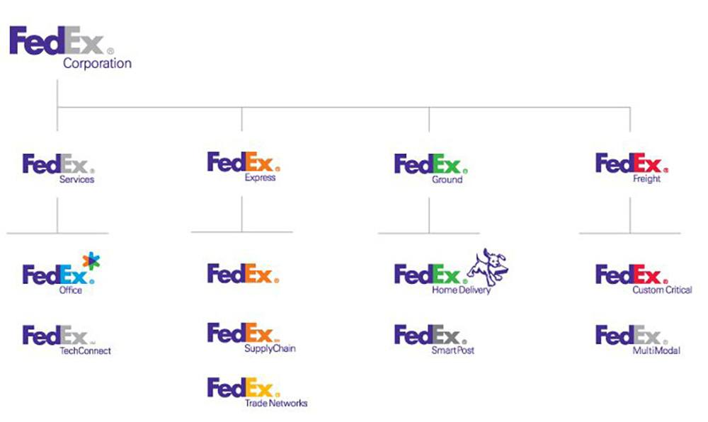
The Branded House

Slide 23
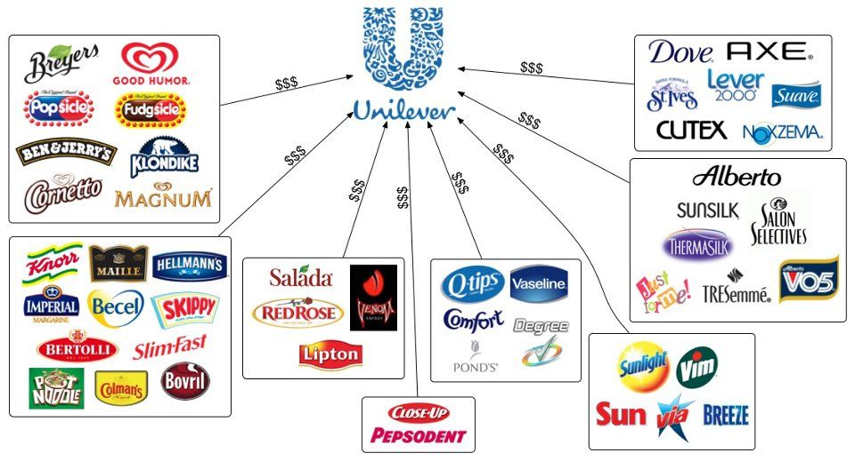
The House of Brands

Slide 24

Endorsed Brand Architecture

Slide 25
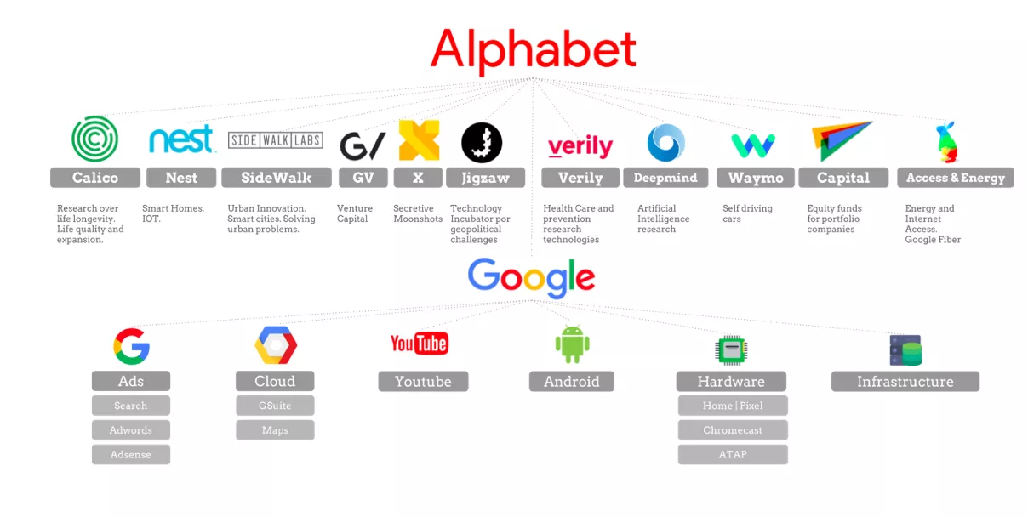
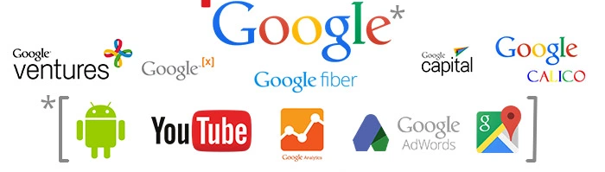
Hybrid Brand Architecture

Slide 26
The Benefits of a Strong Brand Architecture
Clarity in the marketplace
Synergy among brands
Target specific customer segments
Clarity in positioning and communication
Enhance consumer awareness
Build & enhance brand equity

Slide 27

Brand Portfolio
The Brand Portfolio refers to an umbrella under which all the brands or brand lines of a particular firm functions to serve the needs of different market segments.

Slide 28
The brands in the Brand Portfolio play the following different roles
Flanker Brand
Cash Cow Brand
Low-End Entry Level Brand
High-End Prestige Brand

Slide 29
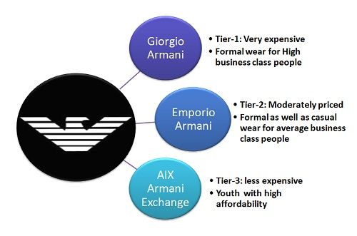
Flanker Brand
A Flanker Brand also known as a Fighter Brand is a new product launched in a market by the company in the same category wherein an established brand is already positioned. This is primarily done for the increased market share as well as to cater to the need of all the segments of customers.

Slide 30

Cash Cow Brand
A cash cow brand is that product in the brand portfolio that has reached the maturity level in the product life cycle but is able to bring in profits necessary for its survival. These brands are not removed from the market because necessary cash is flowing in through its sale which is better than incurring heavy cost on the launch of a new product.

Slide 31
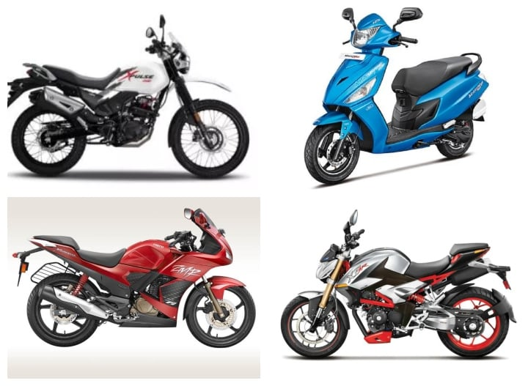
Low-End Entry Level Brand
A low Entry Brand in a brand portfolio includes the product which is offered at less price. The low priced product is added to the portfolio to ensure the purchase at least once and bring the customer into the brand family. Once the customer becomes a part of the family, he is then persuaded for the purchase of the higher priced product in near future.

Slide 32
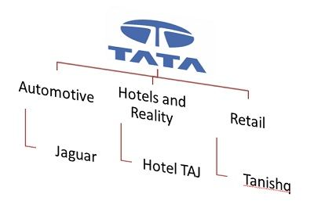
High-End Prestige Brand
A High-End Prestige Brand in the brand portfolio is the product offered at a high price with the intention of creating a sense of prestige in the minds of customers. Other brands in the portfolio also get the recognition because of the premium brand and its quality do have a halo effect on each product line

Slide 33

Brand Development
Line Extension
Brand Extension
Product Flanking
Multi-brand
New Brand

